Slide 1


Koffect
Team ZJY
Notes:
Hello, welcome to the Fall Design Presentation for CS 5001 Senior Design at the University of Cincinnati. Today I, as part of team ZJY, will be presenting the Koffect programming language project.

Slide 2
Team Members
Project Advisor
Jaran Chao
Professor William Hawkins III
Group Members
Notes:
The Koffect project is a solo project and I, Jaran Chao, am the only member of team ZJY.
The project advisor for this project is Professor William Hawkins III.

Slide 3
Project Advisor
Professor William Hawkins III
Group Members
Team Members
Jaran Chao
Notes:
The Koffect project is a solo project and I, Jaran Chao, am the only member of team ZJY.
The project advisor for this project is Professor William Hawkins III.

Slide 4
Group Members
Team Members
Project Advisor
Jaran Chao
Professor William Hawkins III
Notes:
The Koffect project is a solo project and I, Jaran Chao, am the only member of team ZJY.
The project advisor for this project is Professor William Hawkins III.

Slide 5
Koffect is a research language that explores the realm of context-oriented programming focusing on its application to general purpose programming. This innovative project seeks to address the inherent challenges posed by implicit contexts in programming, ranging from mathematical proof writing to resource management to the creation of domain-specific languages. Koffect takes inspiration from many languages with similar features such as algebraic effects/coeffects, implicit parameters, and context receivers from languages such as Kotlin, Scala, Ocaml, Haskell, Koka, Effekt, and Eff. By doing so, Koffect aims to build on the strengths of these languages while innovatively addressing the challenges associated with context management in programming.
Project Abstract

Slide 6
Project Abstract
Koffect is a research language that explores the realm of context-oriented programming focusing on its applications to general purpose programming. This innovative project seeks to address the inherent challenges posed by implicit contexts in programming, ranging from code correctness to resource management to the creation of domain-specific languages. Koffect takes inspiration from many languages with similar features such as algebraic effects/coeffects, implicit parameters, and context receivers from languages such as Kotlin, Scala, Ocaml, Haskell, Koka, Effekt, and Eff. By doing so, Koffect aims to build on the strengths of these languages while innovatively addressing the challenges associated with context management in programming.
Notes:
Koffect is a research language that explores the realm of context-oriented programming focusing on its applications to general purpose programming. It seeks to address the inherent challenges posed by implicit contextual information commonly found in programming. This can range from code correctness in context dependent domains such as mathematical proofs or asynchronous code, to resource and memory management, to the creation and maintenance of domain specific languages. [PAUSE] The Koffect language takes inspiration from many languages, the foremost being Kotlin’s context/multiple receivers. However, other inspirations are implicit parameters from Haskell and Scala as well as algebraic effect/coeffects from languages such as Ocaml, Koka, Effekt, and Eff. Koffect aims to build on the strengths of these languages while tackling the challenges and tradeoffs associated with context oriented programming.

Slide 7
Software Developer
Library Maintainer
I want the language to be expressive and powerful enough to express my complex business logic and business solution. Preferably in an idiomatic, elegant, and concise manner.
I want the language features to be composable such that libraries can be used together without causing conflicts, bugs, and undefined behavior.
User Stories 1

Slide 8
Library Maintainer
I want the language features to be composable such that libraries can be used together without causing conflicts, bugs, and undefined behavior.
User Stories 1
Software Developer
I want the language to be expressive and powerful enough to express my complex business logic and business solution. Preferably in an idiomatic, elegant, and concise manner.

Slide 9
User Stories 1
Software Developer
Library Maintainer
I want the language to be expressive and powerful enough to express my complex business logic and business solution. Preferably in an idiomatic, elegant, and concise manner.
I want the language features to be composable such that libraries can be used together without causing conflicts, bugs, and undefined behavior.

Slide 10
Software Maintainer
User
I want the language to have good tooling for creating maintainable and scalable code solutions and documentation solutions.
I expect programs and applications written in Koffect to be stable and consistent. Behavior of the program/application should be well-defined.
User Stories 2

Slide 11
User
I expect programs and applications written in Koffect to be stable and consistent. Behavior of the program/application should be well-defined.
User Stories 2
Software Maintainer
I want the language to have good tooling for creating maintainable and scalable code solutions and documentation solutions.

Slide 12
User Stories 2
Software Maintainer
User
I want the language to have good tooling for creating maintainable and scalable code solutions and documentation solutions.
I expect programs and applications written in Koffect to be stable and consistent. Behavior of the program/application should be well-defined.

Slide 13
Software Developer
I want the language to have compatibility with multiple platforms so that Koffect code can be run from multiple different hardware architectures. Furthermore, I want the language to have a good multiplatform story to allow for Koffect to be utilized for many different applications.
User Stories 3

Slide 14
User Stories 3
Software Developer
I want the language to have compatibility with multiple platforms so that Koffect code can be run from multiple different hardware architectures. Furthermore, I want the language to have a good multiplatform story to allow for Koffect to be utilized for many different applications.

Slide 15
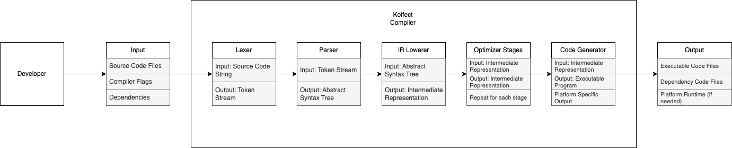
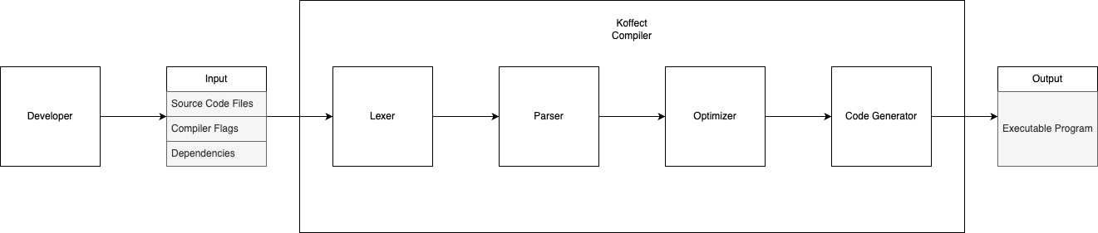
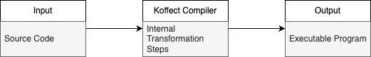
210
Design Diagrams

Slide 16
210
Design Diagrams
Notes:
0 is a overall high level look at the structure of the Koffect project

Slide 17
210
Design Diagrams
Notes:
1 is a more detailed look, specifying the separate steps inside the Koffect compiler

Slide 18
Design Diagrams
210
Notes:
2 is the most detailed look, specifying how each internal step integrates with each other [EXPLAIN STEPS]

Slide 19
Time Constraint
Economic Constraint
Professional Constraint
Developing a programming language is complex, involving a compiler, a runtime, a comprehensive standard library, and community support. The project acknowledges the time required for maturity, emphasizing the need for various tooling, including developer and build/distribution tools.
The project aims to leverage free and open-source frameworks and libraries to reduce development effort, especially for later milestones like the Language Server Protocol. The choice of an open-source license (GNU GPLv3) may restrict the use of other open-source software and emphasizes acknowledgment rather than paywall-based distribution.
The project creator lacks formal professional experience in programming language development, compilers, and interpreters. Success in this endeavor would serve as professional credibility. The ad-hoc and subjective nature of design and implementation concepts may require seeking input and perspectives from various sources.
Project Constraints
Notes:
This project has 3 major constraints:
Time
Economic
Professional

Slide 20
Economic Constraint
Professional Constraint
The project aims to leverage free and open-source frameworks and libraries to reduce development effort, especially for later milestones like the Language Server Protocol. The choice of an open-source license (GNU GPLv3) may restrict the use of other open-source software and emphasizes acknowledgment rather than paywall-based distribution.
The project creator lacks formal professional experience in programming language development, compilers, and interpreters. Success in this endeavor would serve as professional credibility. The ad-hoc and subjective nature of design and implementation concepts may require seeking input and perspectives from various sources.
Project Constraints
Time Constraint
Developing a programming language is complex, involving a compiler, a runtime, a comprehensive standard library, and community support. The project acknowledges the time required for maturity, emphasizing the need for various tooling, including developer and build/distribution tools.
Notes:
This project has 3 major constraints:
Time
Economic
Professional

Slide 21
Professional Constraint
The project creator lacks formal professional experience in programming language development, compilers, and interpreters. Success in this endeavor would serve as professional credibility. The ad-hoc and subjective nature of design and implementation concepts may require seeking input and perspectives from various sources.
Project Constraints
Time Constraint
Economic Constraint
Developing a programming language is complex, involving a compiler, a runtime, a comprehensive standard library, and community support. The project acknowledges the time required for maturity, emphasizing the need for various tooling, including developer and build/distribution tools.
The project aims to leverage free and open-source frameworks and libraries to reduce development effort, especially for later milestones like the Language Server Protocol. The choice of an open-source license (GNU GPLv3) may restrict the use of other open-source software and emphasizes acknowledgment rather than paywall-based distribution.
Notes:
This project has 3 major constraints:
Time
Economic
Professional

Slide 22
Project Constraints
Time Constraint
Economic Constraint
Professional Constraint
Developing a programming language is complex, involving a compiler, a runtime, a comprehensive standard library, and community support. The project acknowledges the time required for maturity, emphasizing the need for various tooling, including developer and build/distribution tools.
The project aims to leverage free and open-source frameworks and libraries to reduce development effort, especially for later milestones like the Language Server Protocol. The choice of an open-source license (GNU GPLv3) may restrict the use of other open-source software and emphasizes acknowledgment rather than paywall-based distribution.
The project creator lacks formal professional experience in programming language development, compilers, and interpreters. Success in this endeavor would serve as professional credibility. The ad-hoc and subjective nature of design and implementation concepts may require seeking input and perspectives from various sources.
Notes:
This project has 3 major constraints:
Time
Economic
Professional

Slide 23
Research
Finalization
Documentation
Conducting research into many different aspects of programming language implementation and design and weighing tradeoffs.
Finalization of:
Language paradigms
Implementation language
Desired deliverables
In progress to finalize:
Syntax
Language features
Compiler and Runtime structure
Currently documenting all project related research in design notes. Official documentation will be created pending finalization and results of research.
Project related code changes is documented through a version control system, git, and uploaded to GitHub.
Review of Progress
Notes:
Review of progress:
Research
Finalization
Documentation

Slide 24
Finalization
Documentation
Finalization of:
Language paradigms
Implementation language
Desired deliverables
In progress to finalize:
Syntax
Language features
Compiler and Runtime structure
Currently documenting all project related research in design notes. Official documentation will be created pending finalization and results of research.
Project related code changes is documented through a version control system, git, and uploaded to GitHub.
Review of Progress
Research
Conducting research into many different aspects of programming language implementation and design and weighing tradeoffs.
Notes:
Review of progress:
Research
Finalization
Documentation

Slide 25
Documentation
Currently documenting all project related research in design notes. Official documentation will be created pending finalization and results of research.
Project related code changes is documented through a version control system, git, and uploaded to GitHub.
Review of Progress
Research
Finalization
Conducting research into many different aspects of programming language implementation and design and weighing tradeoffs.
Finalization of:
Language paradigms
Implementation language
Desired deliverables
In progress to finalize:
Syntax
Language features
Compiler and Runtime structure
Notes:
Review of progress:
Research
Finalization
Documentation

Slide 26
Review of Progress
Research
Finalization
Documentation
Conducting research into many different aspects of programming language implementation and design and weighing tradeoffs.
Finalization of:
Language paradigms
Implementation language
Desired deliverables
In progress to finalize:
Syntax
Language features
Compiler and Runtime structure
Currently documenting all project related research in design notes. Official documentation will be created pending finalization and results of research.
Project related code changes is documented through a version control system, git, and uploaded to GitHub.

Slide 27
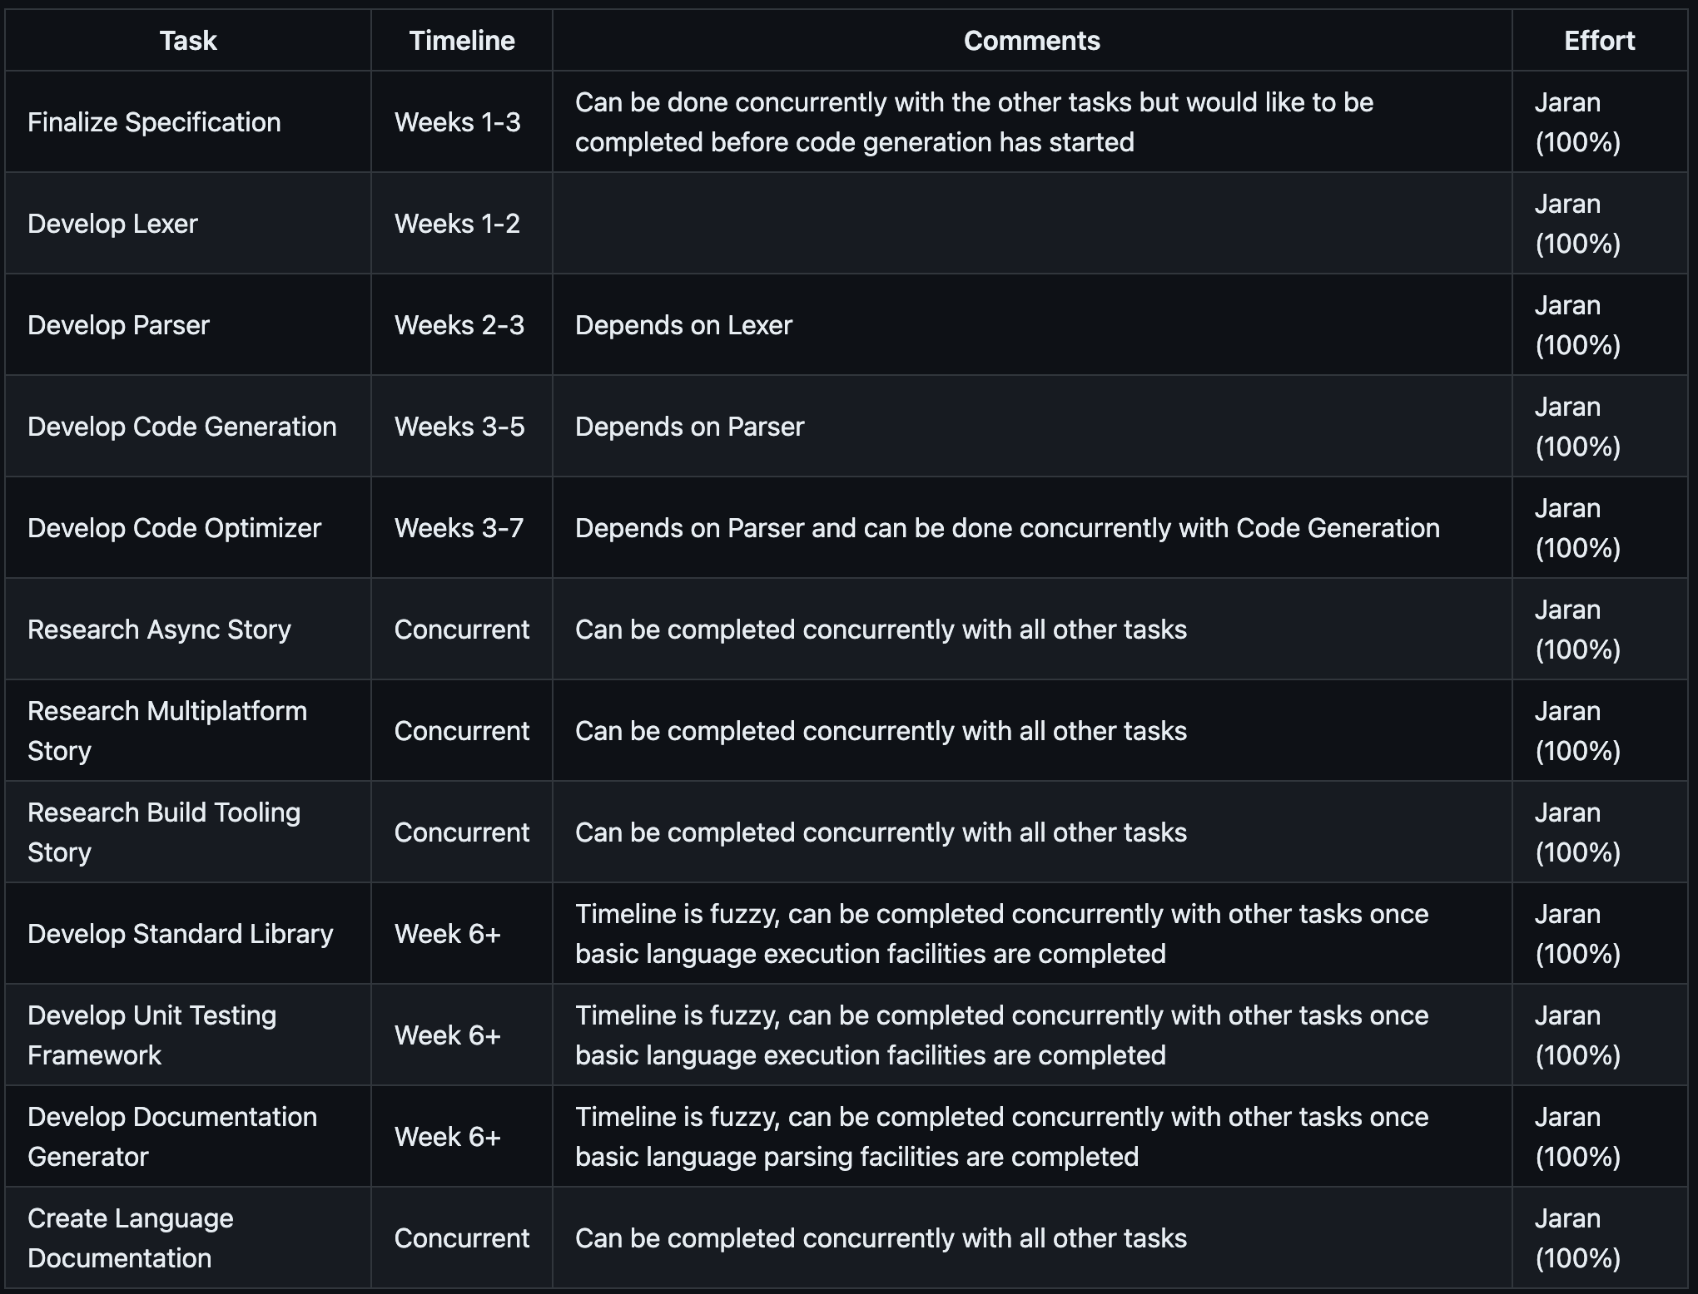
As I, Jaran Chao, am the only member of my team, I will be responsible for all work pertaining to the Koffect language.
Division of Work
Notes:
As I, Jaran Chao, am the only member of my team, I will be responsible for all work pertaining to the Koffect language.

Slide 28
Division of Work
As I, Jaran Chao, am the only member of my team, I will be responsible for all work pertaining to the Koffect language.
Notes:
As I, Jaran Chao, am the only member of my team, I will be responsible for all work pertaining to the Koffect language.

Slide 29
The primary demo of the language will be a start from scratch to fully functioning program demo. This demo may be multiple different code files depicting the multiple different features and paradigms supported by Koffect. The main code file will be demonstrating the context-oriented features of Koffect.
Expected Demo

Slide 30
Expected Demo
The primary demo of the language will be a start from scratch to fully functioning program demo. This demo may be multiple different code files depicting the multiple different features and paradigms supported by Koffect. The main code file will be demonstrating the context-oriented features of Koffect.

Slide 31

Notes:
Thank you for viewing this presentation on the Koffect language. If you have any questions, please refer to the project github for the best ways of getting in contact.

